Slide 1
Theme
Mack 2023

Slide 2
Learning Objectives
Students will understand the concept of theme in board game design.
Students will be able to explain how themes can enhance the mechanics of a board game.
Students will analyze the impact of the theme on player immersion in board games.

Slide 3
Theme
A theme is a unifying idea that is present throughout a game’s mechanics, narrative, audio, visual effects, and general aesthetic.
A strong theme that is consistent across all of these pieces of content aids immersion for the players through resonance.
Examples of theme used in games include:
■ Medieval with High Fantasy (E.g., Dragons)
■ Space
■ Modern Day
■ Futuristic

Slide 4
Theme
Your goal is to come up with a new Theme for Us vs. It
The game is not selling well and the publisher has decided that the current theme is too masculine and wants a more exciting and equitable theme.
This involves re-doing the narrative, renaming the game, renaming each ability (including their custom ability), and re-theming the player controlled characters (the tanks). The game’s mechanics must remain intact.

Slide 5
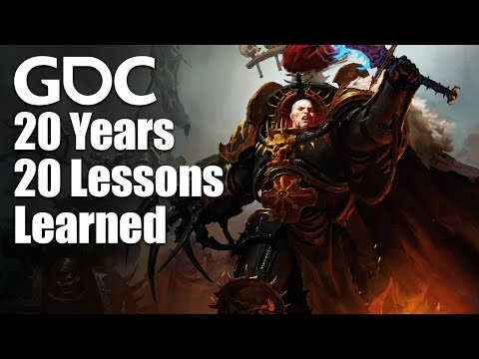
Resonance

Slide 6
Think about resonance and dissonance.
Is this something that a player can imagine role-playing (acting as if they were that character)?
If the theme is “dragon," the ability to replace is laser and the student chose “throw a rock," it is not as thematically resonant as “breathe fire” or “shoot a fireball."
Breathing fire makes you feel like a dragon (you could imagine being that character), whereas throwing rocks feels lame and is unlikely to immerse a player.
Resonant designs use the narrative, art, sound, theme, and mechanics (game rules) together to reinforce the tone and themes of a game and create a greater sense of immersion.
In dissonant designs, the narrative, thematic, and mechanics clash, which reduce immersion.
Players come with expectations preset for thematics, that will differ by culture.

Slide 7
Example
Western dragons and Eastern dragons carry different expectations within their audiences.
A game that depicts a dragon as having a fiery temperament or being greedy may run afoul of a primarily Eastern audience that perceives dragons as being auspicious or lucky

Slide 8
Piggy Backing
Think about how choosing your theme can explain otherwise nonsensical behavior.
If our new theme is “library," it is unlikely that the students will find a good fit for the “laser” ability, because it has long range.
If our new theme is “dragons," laser could easily be replaced by “shoot a fireball."

Slide 9
Motivation and Narrative
Think about the motivations of the characters and the overall narrative.
Who would be invading an area (the robot) and who would want to stop them (the tanks)?
Perhaps it’s a territorial dispute between cats and dogs.
We wouldn’t choose a theme where two sides don't like fighting as it is likely to be dissonant (E.g., two villages of pacifists who live near each other).

Slide 10
Theme Exercise
Brainstorm
Students populate a list of all the ideas for themes they can think of. There are no bad ideas. Encourage them to create a list of at least 10 ideas.
Examples
■ Cats vs Dogs
■ Good vs Evil
■ Nature vs Society
■ Diseases (The Plague) vs Humanity

Slide 11
Need some Help?
Popular Media
Fantasy
Society
Whacky Themes
Sports
Romance
Genres
Friends
etc.

Slide 12
Narrow it Down!
Students cut their list down to the top 1 or 2 ideas.
Students should spend the next 10 minutes debating within their groups and cutting ideas that are not going to work, due to the criteria below (or some other criteria).
Checklist
☑ Narrative is resonant.
Are these two parties likely to be in conflict?
☑Able to re-theme the mechanics appropriately.
☑Appropriate theming for the player controlled characters (tanks) and the main character (robot).
☑Ability to create new abilities.

Slide 13
Complete the Theme
Students take one of the ideas to completion, including the following components:
Narrative
Game Name
“Robot Name”
“Robot” (should no longer be a robot)
Ability Names
“Tanks” (these should no longer be tanks)

